Slide 1
12515 - Little Brick's Dream

Slide 2
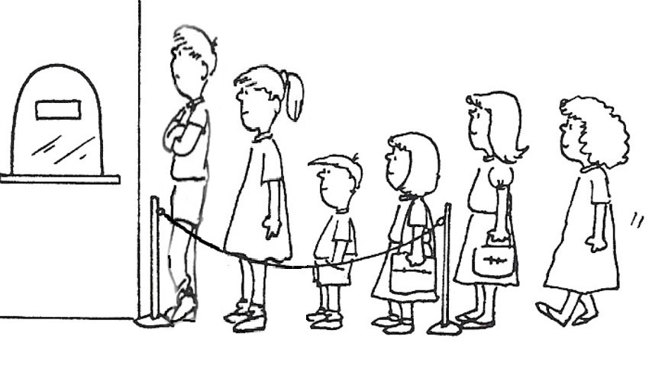
Problem
Little Brick told you that he is waiting in a long line.
Can you find Little Brick’s position based on his comfort level?

Slide 3

Input
Comfort level f(i) of person i:
the number of consecutive people standing in front of him, and are shorter than him.
The first line contains 2 integers N, X, N is the number of people,
X is the comfort level. 1 <= N,X <= 10^7
f(9)=
3
3
2
1
1 2 3 4 5 6 7 8 9

Slide 4
Output
Print all possible positions, separated by blanks. If there is no possible position, output “ouo”

Slide 5
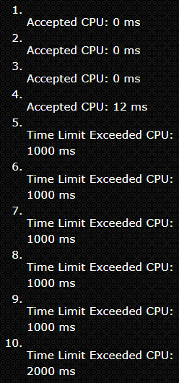

Idea - Brute force
If we compare all the people before little brick until someone taller than him.
Time complecity: O(n^2)
0
0
1
1
End
End
0
End
End
1 2 3 4 5 6

Slide 6
Idea - Enhanced
Use an array confort_level[ ] to save the confort levels.
Consider f(5):
heights[5] > heights[4]
since f(4) = 1, jump to 4 - f(4) – 1 = 2
1
1 2 3 4 5 6

Slide 7
Idea - Enhanced
Use an array confort_level[ ] to save the confort levels.
Consider f(5):
heights[5] > heights[4]
since f(4) = 1, jump to 4 - f(4) – 1 = 2
2. heights[5] < heights[2], we can compute f(5) = 5 – 2 – 1 = 2.
1
End
Based on the f(4) = 1,
we can skip this step
1 2 3 4 5 6

Slide 8
Code
for( i=1; i<=n; i++) {
scanf("%d", &heights[i]);
for( j=i-1; j>=1; ) {
if(heights[j] < heights[i])
else break;
}
confort_level[i] = i-j-1;
if(confort_level[i] == target) ans[cnt++] = i;
}
j -= confort_level[j]+1;
1 2 3 4 5 6

